Slide 1
Pybullet Simulator Manual
asdfasdf

Slide 2

1. Installation
1) Anaconda
① Install anaconda from https://www.anaconda.com/
①

Slide 3
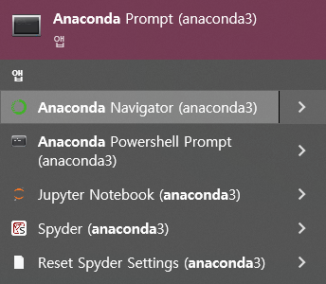
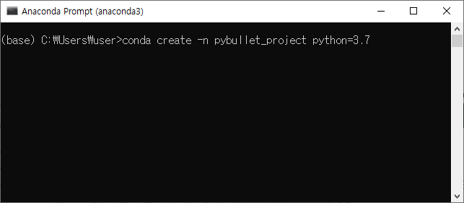
1. Installation
1) Anaconda
② Open anaconda prompt, and create new environment
①
②
>conda create -n [env name] python=[python version]

Slide 4
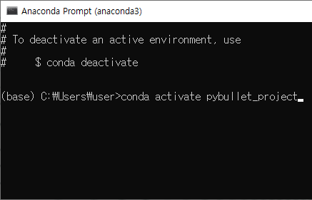
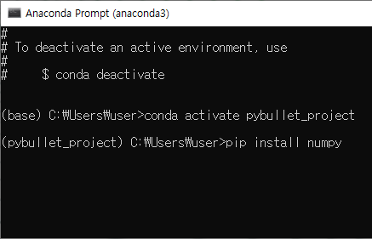
1. Installation
1) Anaconda
② Activate new environment, and install libraries
①
②
>conda create activate [env name]
>pip install numpy matplotlib jupyter pybullet

Slide 5

1. Installation
2) Pycharm (or any python IDE)
① Install pycharm from https://www.jetbrains.com/ko-kr/pycharm/
①

Slide 6
1. Installation
2) Pycharm (or any python IDE)
② Download source code from
①

Slide 7
1. Installation

Slide 8
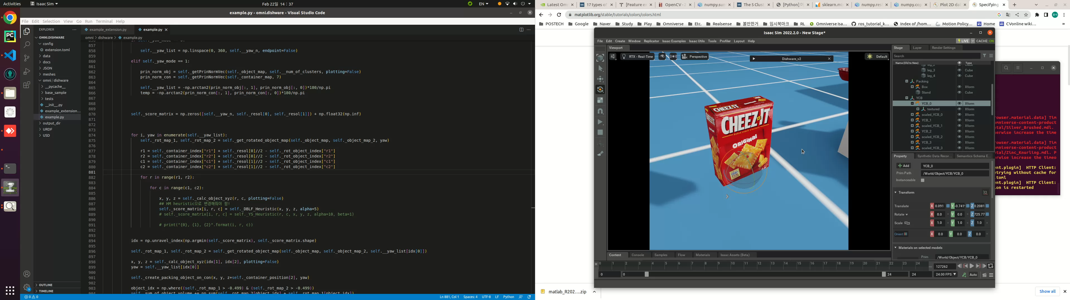
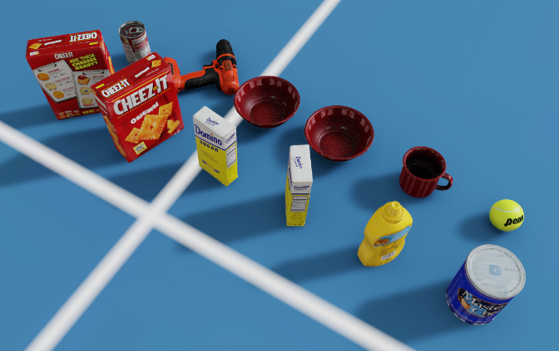
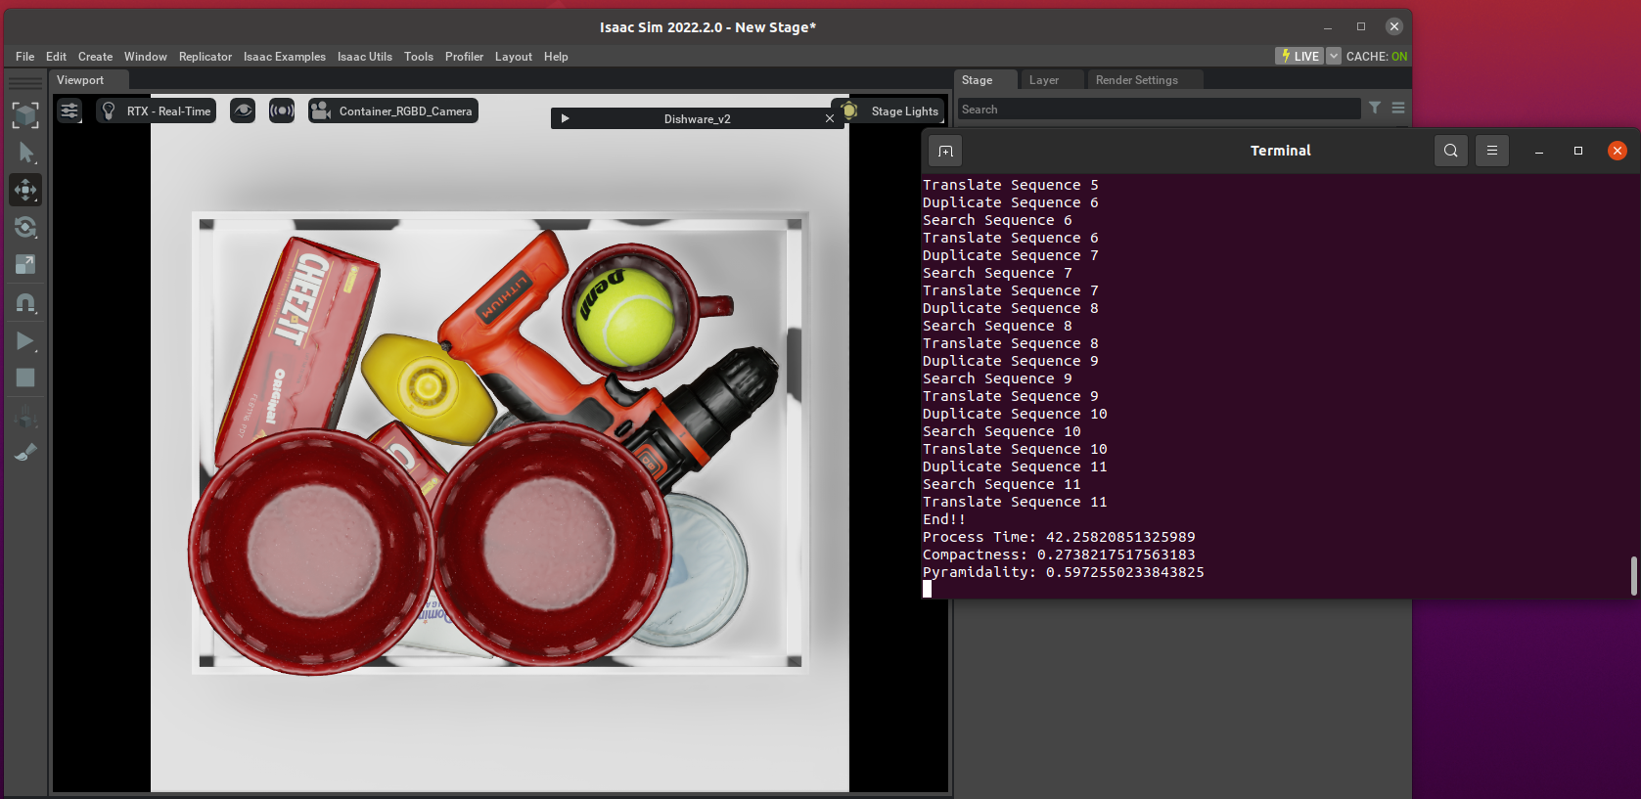
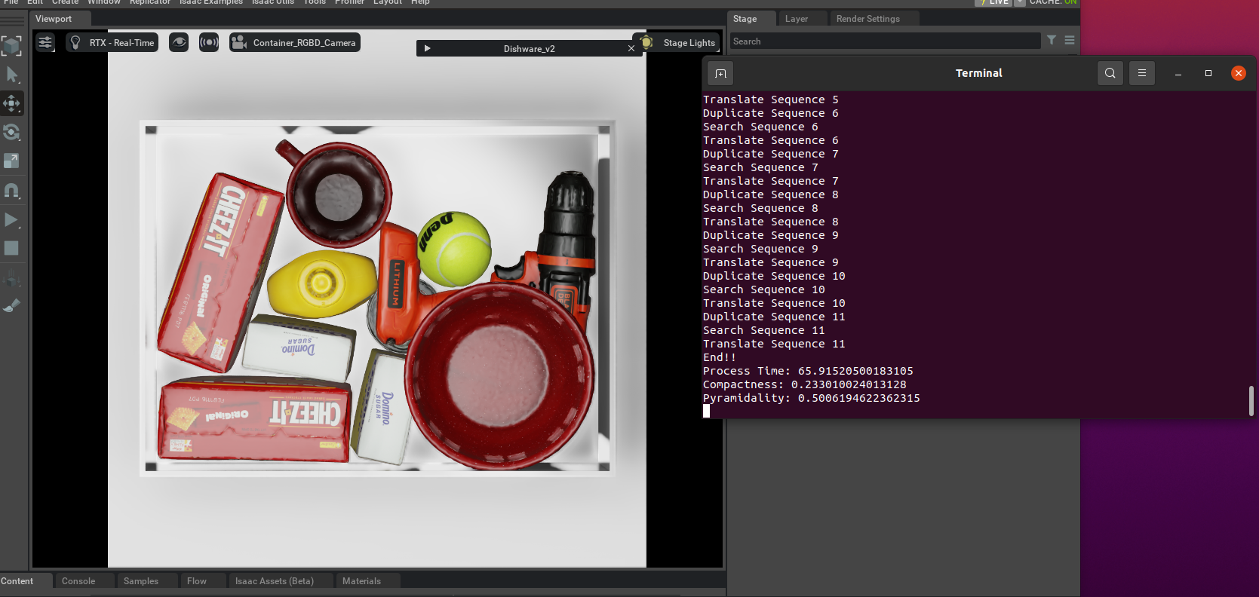
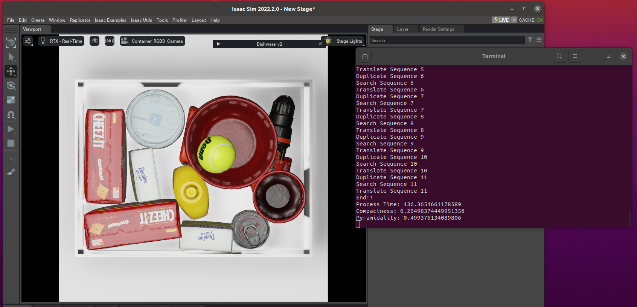
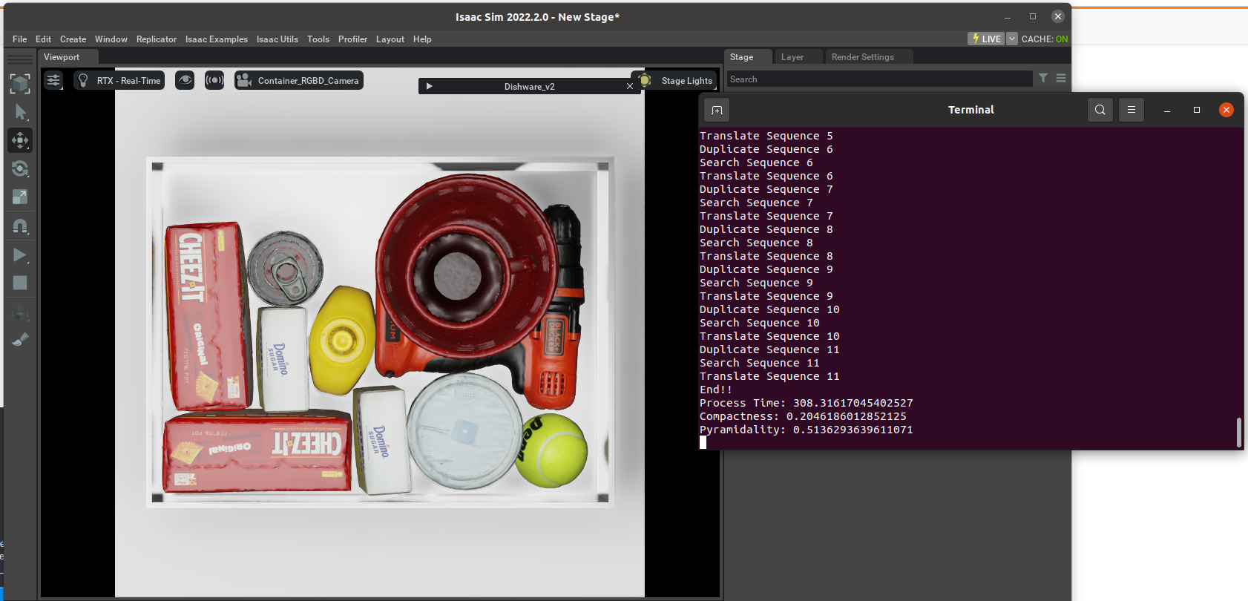
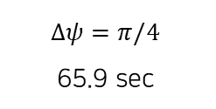
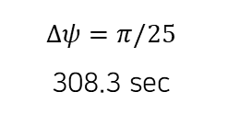
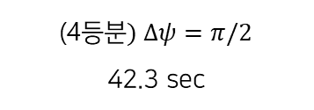
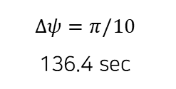
현재 진행중인 연구 방향
Object packing search space reduction based on visual clues
0. Dense packing을 위해서는 orientation searching interval이 정말로 중요한가..?
(4등$분) Δψ=π/2$
42.3 sec
$$Δψ=π/4$$
65.9 sec
$$Δψ=π/10$$
136.4 sec
$$Δψ=π/25$$
308.3 sec

Slide 9
현재 진행중인 연구 방향
Object packing search space reduction based on visual clues
1. Orientation search space reduction based on visual clues
Filter
Visual clues
(normal map, depth map, etc.)
Continuous orientation space
Candidates of searching orientation

Slide 10
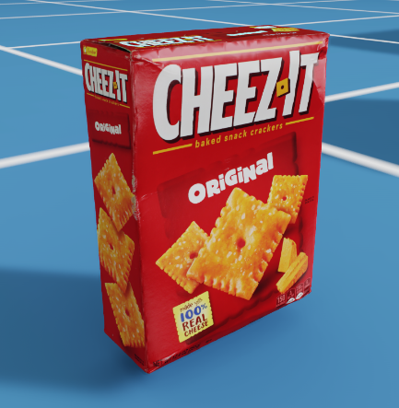
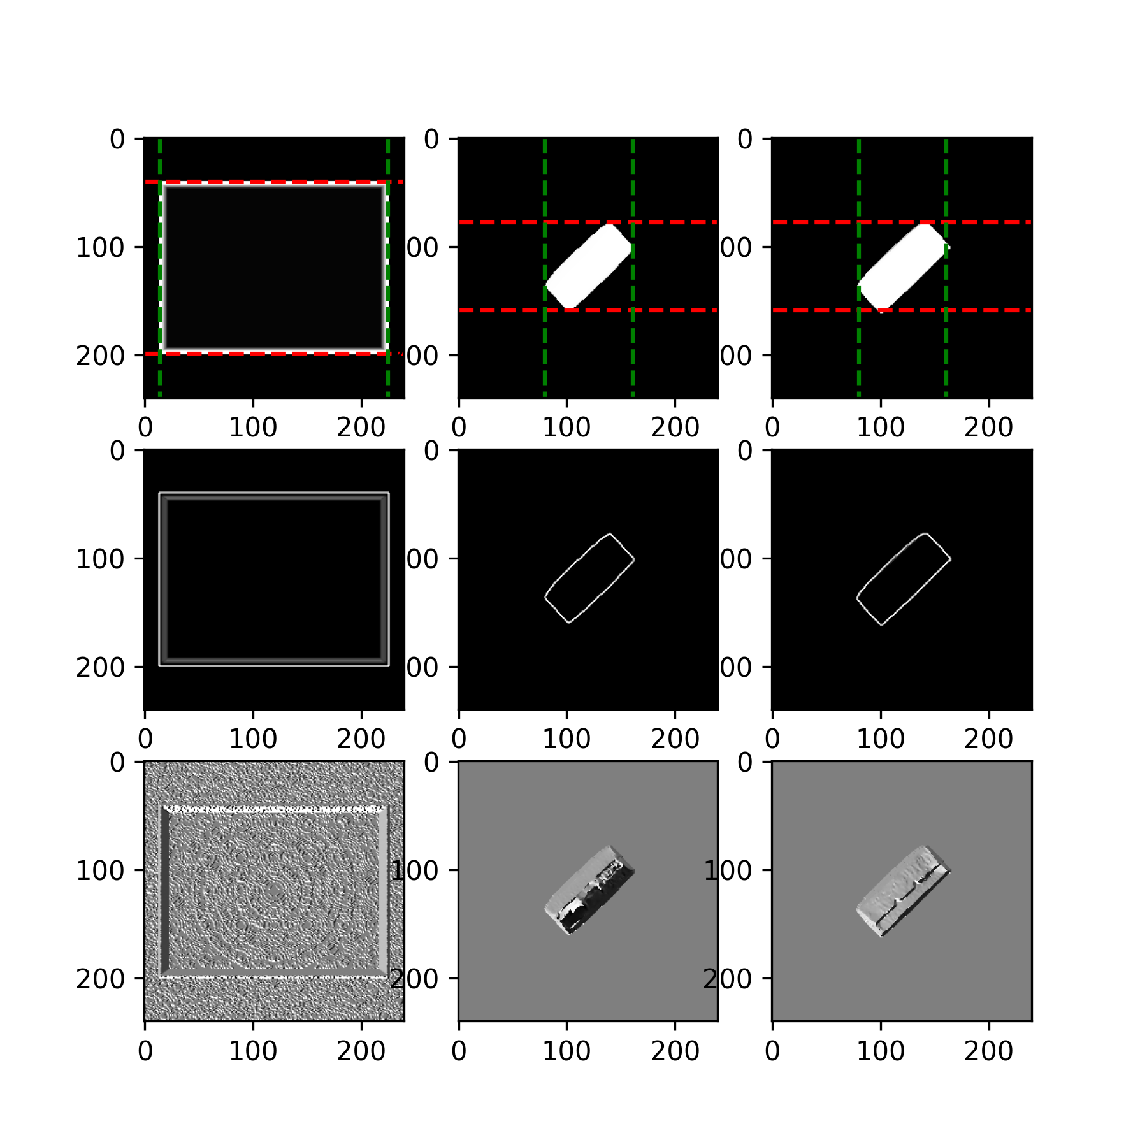
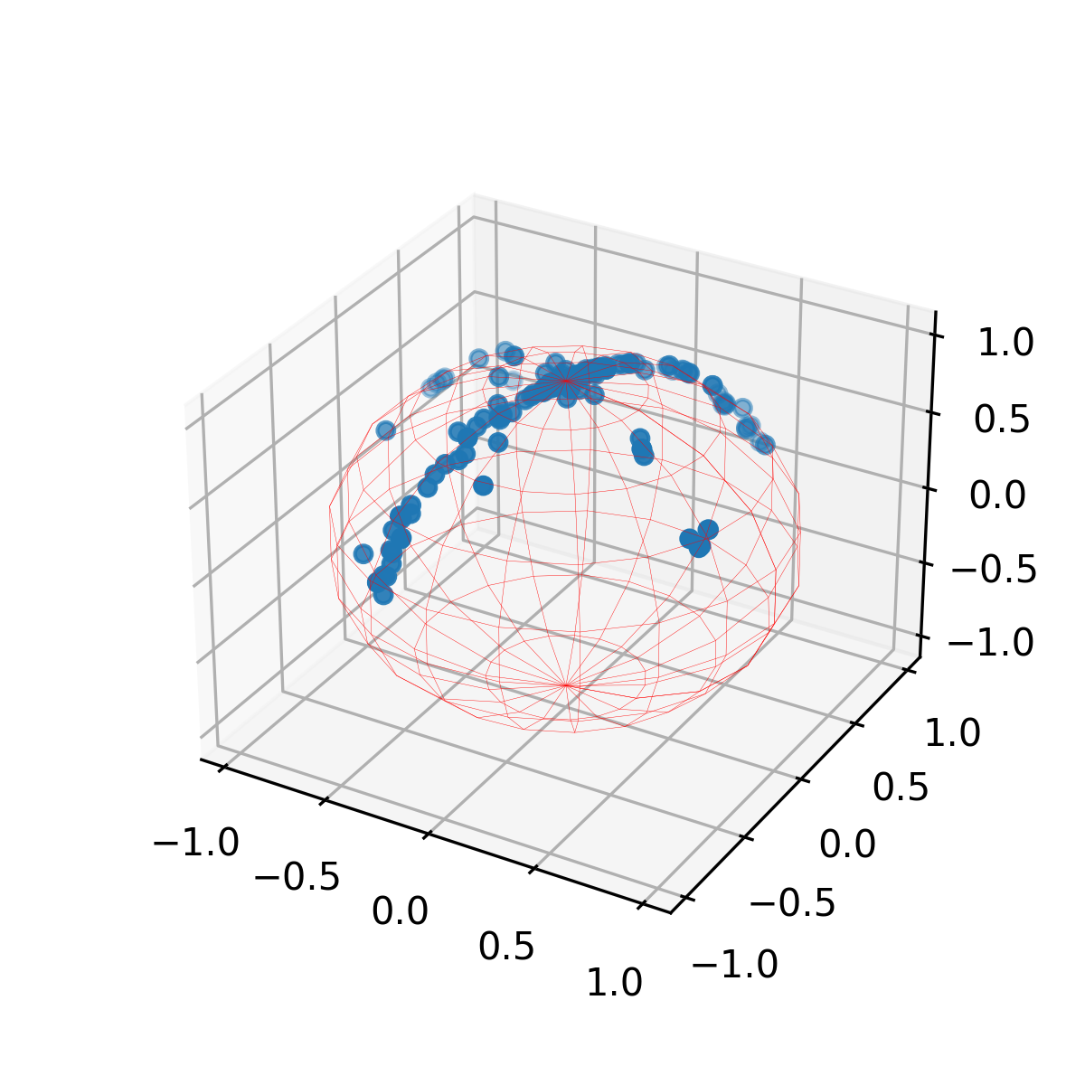
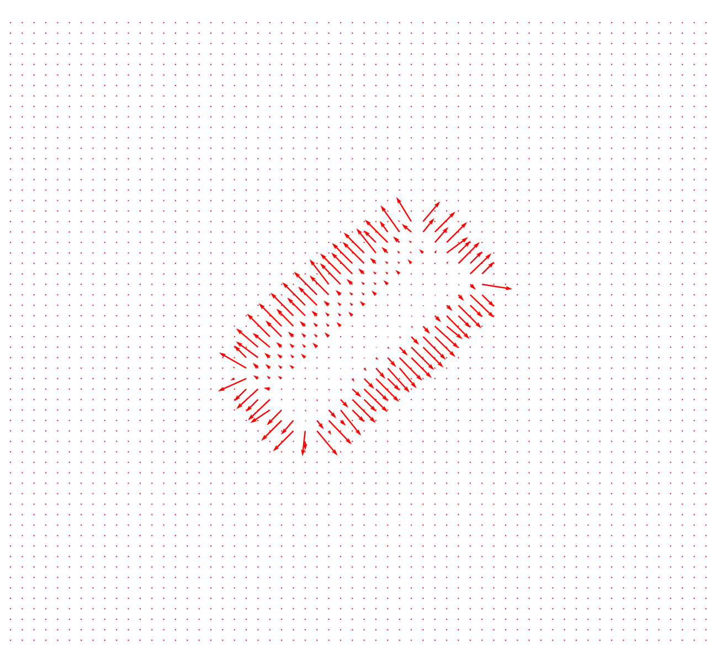
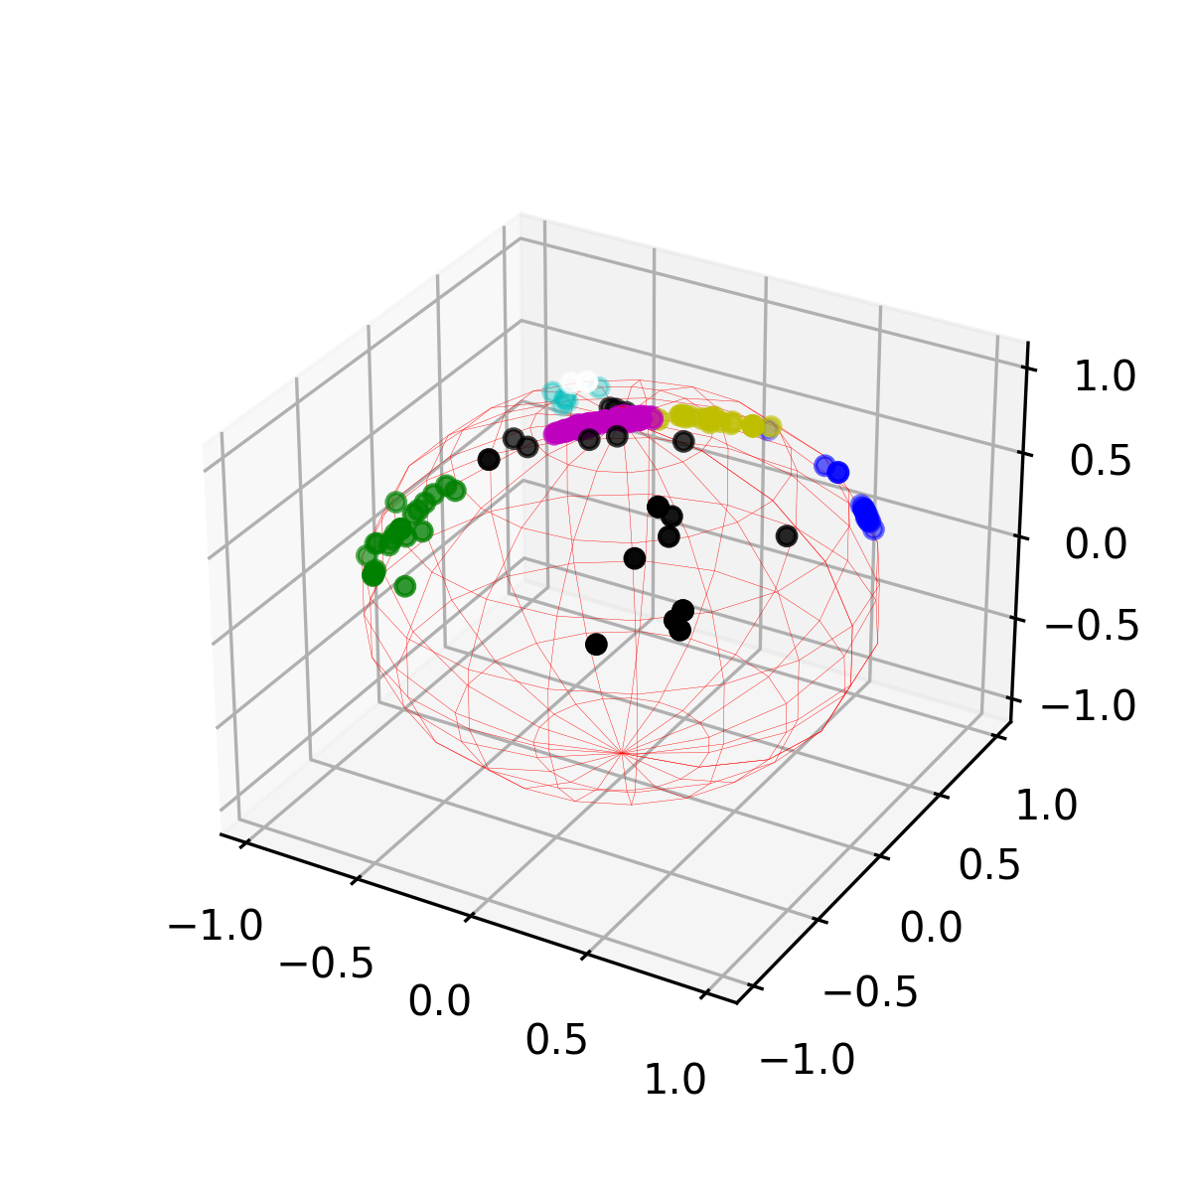
현재 진행중인 연구 방향
Object packing search space reduction based on visual clues
2. Simple feasibility test
① Obtain depth map
② Calculate normal map
③ Cluster normal map

Slide 11
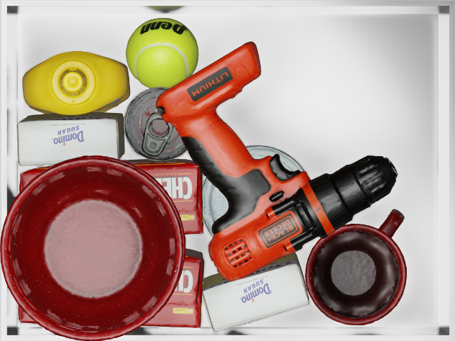
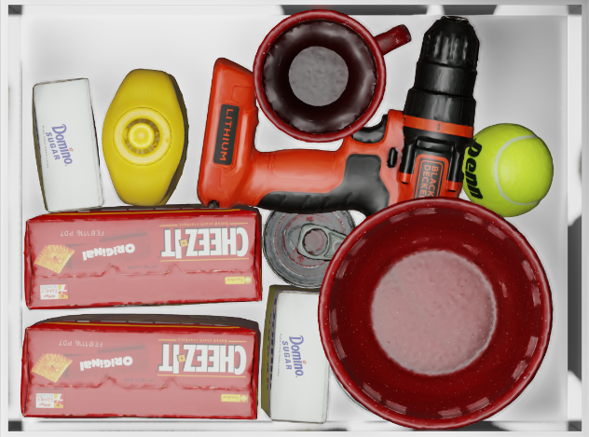
현재 진행중인 연구 방향
Object packing search space reduction based on visual clues
2. Simple feasibility test
# of candidate = 4
48.9 sec
# of candidate = 8
73.4 sec

Slide 12
연구 진행계획
평가항목 정하기
3차원 회전까지 고려
물체와 적재함의 Geometric feature를 고려
Orientation space 뿐만 아니라 Position space도 volume reduction 하기
적재할 물체의 Stability 고려
Graspability

